Slide 1
CHINOOK MUSIC STORE ANALYSIS
BY
NAGANATHAN ARJUN MANICKA SRIDHAR

Slide 2
Agenda
Problem Statement
Data Description
Objective Key Metrics and Visualizations
Subjective Question for Insights

Slide 3
Problem Statement
Chinook seeks to gain insights into customer purchasing behavior and market dynamics in the music industry.
By analyzing sales data, the company aims to identify top-selling tracks and artists, understand customer demographics, and assess purchasing trends across different genres and geographic locations.
This analysis will facilitate targeted marketing strategies, enhance customer retention efforts, and inform promotional initiatives for new record label albums based on genre performance and regional preferences.
Additionally, Chinook aims to develop risk profiles for customer segments to better predict churn and improve customer lifetime value modeling.

Slide 4
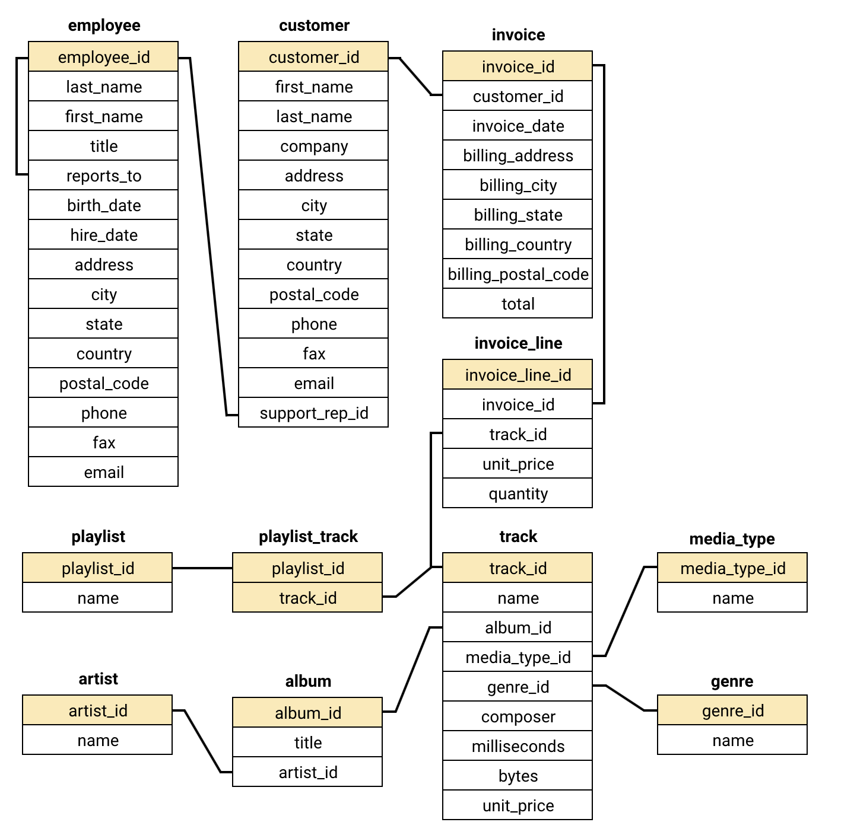
Database Schema

Slide 5
DATA DESCRIPTION

Slide 6
Data Description
customer:
customer_id: Unique identifier assigned to each customer.
first_name: The given name or first name of a customer.
last_name: The surname or family name of a customer.
company: The name of the company associated with a customer.
address: The street address of a customer's location.
city: The city where a customer is located.
state: The state or province where a customer is located.
country: The country where a customer is located.
postal_code: The postal or zip code of a customer's address.
phone: The phone number of a customer.
fax: The fax number associated with a customer.
email: The email address of a customer.
support_rep_id: The employee ID of the support representative assigned to a customer.
invoice_line:
invoice_line_id: Unique identifier assigned to each line item on an invoice.
invoice_id: The invoice ID to which the line item belongs.
track_id: The ID of the track or product included in the line item.
unit_price: The price per unit for the line item.
quantity: The quantity of units for the line item.

Slide 7
Data Description
invoice:
invoice_id: Unique identifier assigned to each invoice.
customer_id: The customer ID associated with the invoice.
invoice_date: The date when the invoice was generated or issued.
billing_address: The street address used for billing purposes.
billing_city: The city used for billing purposes.
billing_state: The state or province used for billing purposes.
billing_country: The country used for billing purposes.
billing_postal_code: The postal or zip code used for billing purposes.
total: The total amount due on the invoice.
playlist:
playlist_id: Unique identifier assigned to each playlist.
name: The name or title of the playlist.
playlist_track:
playlist_id: The ID of the playlist to which the track belongs.
track_id: The ID of the track included in the playlist.
genre:
genre_id: Unique identifier assigned to each genre.
name: The name or description of the genre (e.g., rock, pop, classical).

Slide 8
Data Description
track:
track_id: Unique identifier assigned to each track or song.
name: The title or name of the track.
album_id: The ID of the album to which the track belongs.
media_type_id: The ID of the media type associated with the track.
genre_id: The ID of the genre associated with the track.
composer: The name of the composer or artist who composed the track.
milliseconds: The duration of the track in milliseconds.
bytes: The file size of the track in bytes.
unit_price: The price per unit for the track.
album:
album_id: Unique identifier assigned to each album.
title: The title or name of the album.
artist_id: The ID of the artist associated with the album.
artist:
artist_id: Unique identifier assigned to each artist.
name: The name of the artist.
media_type:
media_type_id: Unique identifier assigned to each media type.
name: The name or description of the media type (e.g., MPEG audio file, AAC audio file).

Slide 9
OBJECTIVE KEY METRICS AND VISUALIZATIONS

Slide 10
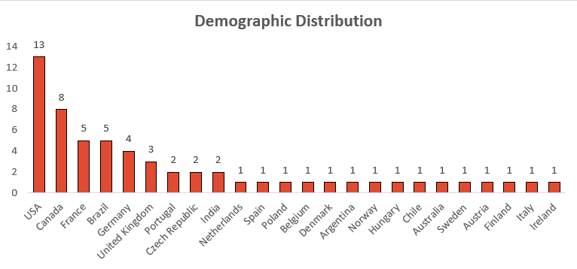
Demographic Distribution
This slide provides an overview of the customers distributed across different geographic locations.
USA has the highest number of customers in the list followed by Canada, France, Brazil and Germany.
Other countries like Portugal, India, Spain, Belgium, Argentina, Norway etc. have 1 or 2 customers.

Slide 11
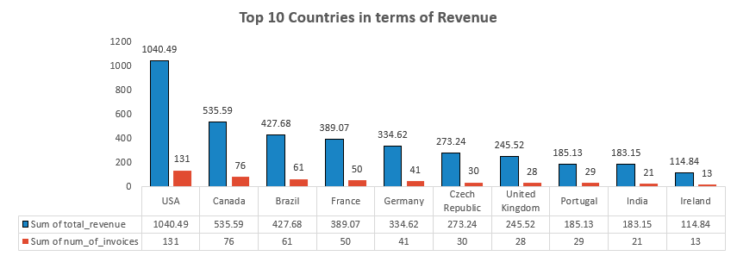
Revenue Across Countries
The bar chart shows us the revenue based on the track sales in all the countries.
For better visualization, we have considered the top 10 countries in terms of revenue.
The highest sale is in USA with an amount of 1040.49 and 131 purchases, followed by Canada and Brazil in the 2nd and 3rd places respectively.
This visualization helps us to focus on the sales based on the geographic location.

Slide 12
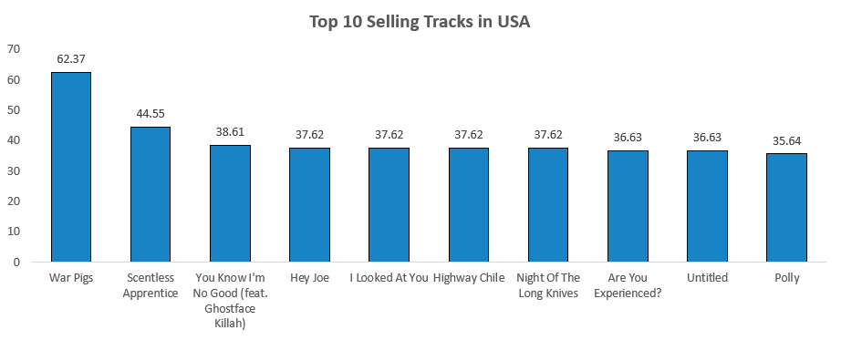
Top-Selling Tracks
The visual displays the top 10 selling tracks in USA which conveys the following:
War Pigs is the highest selling track in USA generating a revenue of 62.37 followed by Scentless Apprentice with a revenue of 44.55.
More customers have purchased the track named War Pigs comes to the track named Scentless Appearance.
This information helps in understanding the customer preferences of the tracks based on the purchase.

Slide 13
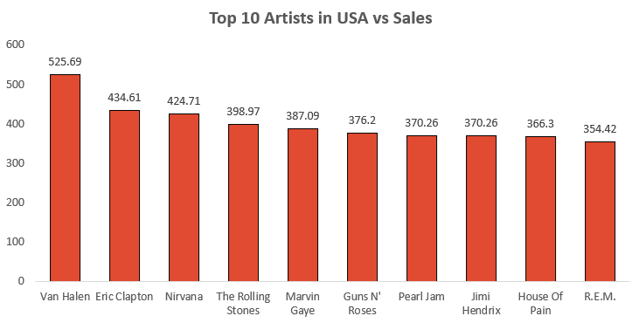
Top-Selling Artists
The visual depicts the top selling artists in USA from the given data. We can infer the following from the visual as follows:
Van Helen is the top selling artist in USA with a revenue of 525.69 followed by Eric Clapton.
This data can help us identify the top artists related to the tracks and genre and also recommend them to the customers who have similar preferences.

Slide 14
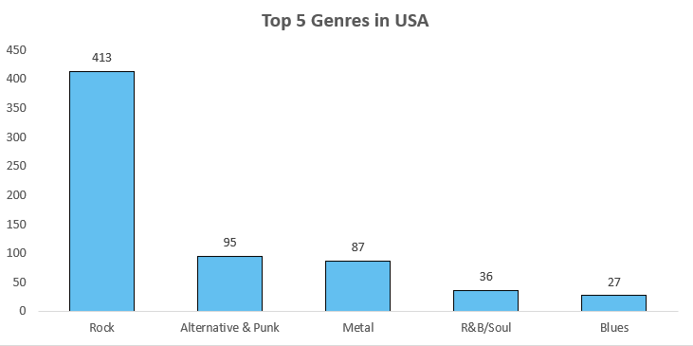
Famous Genres - (Count of Tracks Sold)
We can observe the top 5 genres in USA with respect to the number of tracks sold.
The Rock genre has the most number of tracks sold (413), followed by Alternative & Punk and Metal.
This visual helps us to understand the customer’s preferences on genres with which we can recommend similar genres to the customer for future purchases.

Slide 15
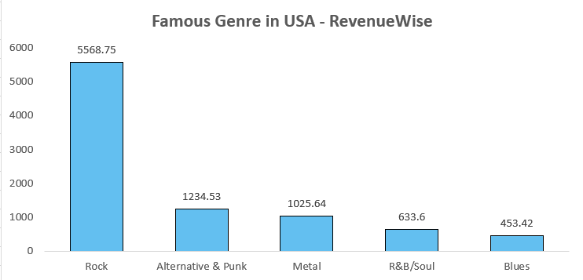
Famous Genres in USA in terms of Revenue
The chart besides displays the top 5 genres in USA with regard to the revenue generated in terms of sales.
The Rock genre has generated the most revenue in USA, followed by Alternative & Punk and Metal.
This visual helps us to identify the best selling genre and the customer’s music preferences so that recommendations can be done for future purchases.

Slide 16
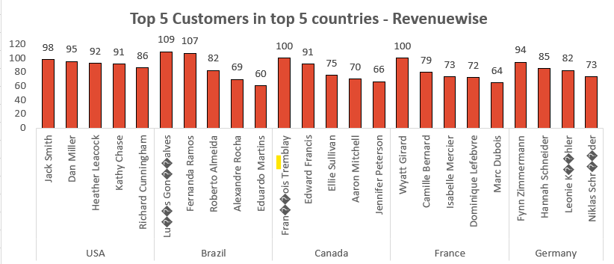
Top 5 Customers in Top 5 countries with highest Revenues
The visual depicts the customers who made top 5 purchases in their respective countries in terms of revenue.
This information can help to target the specific customer segment and also provide recommendations to boost the sales further in the future.

Slide 17
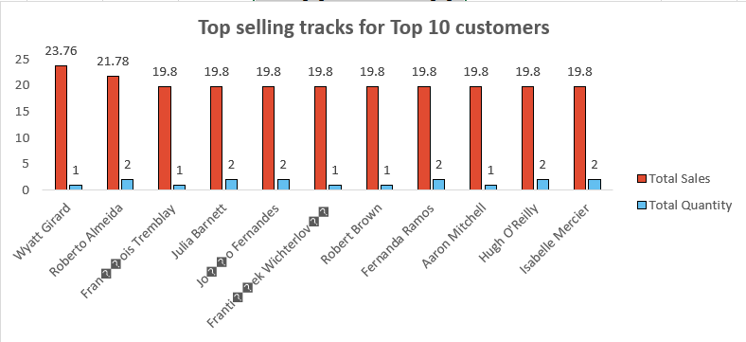
Top Selling Tracks for customers
The visual displays the top selling tracks in USA based on the customers.
Since there are more customers, we have considered the top 10 customers based on the total sales.
The customer named Wyatt Girard has made the highest purchase of 23.76 for a single track.
This chart helps us to get an insight of how much revenue has been generated through the purchases made by various customers.

Slide 18
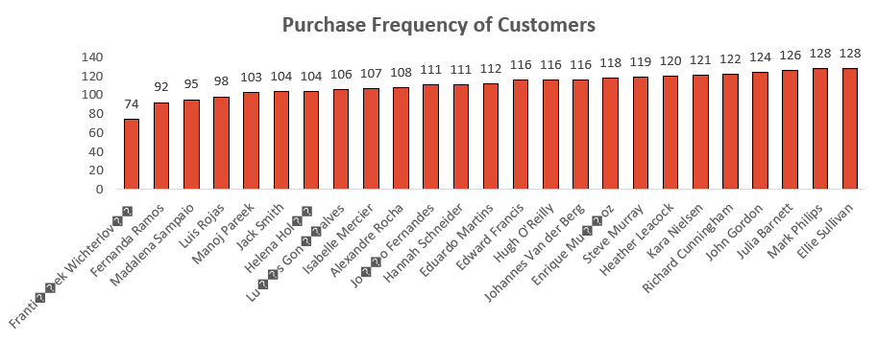
Purchase Frequency
The visual displays the purchase frequency of customers which is the average amount of days difference that a customer takes to do a new purchase.
In this case, customer 1 makes a purchase on an average of every 74 days which is better compared to the customer who places an order every 128 days in average.
This helps us to determine which customers are active and the customers that are inactive for quite a period of time.

Slide 19
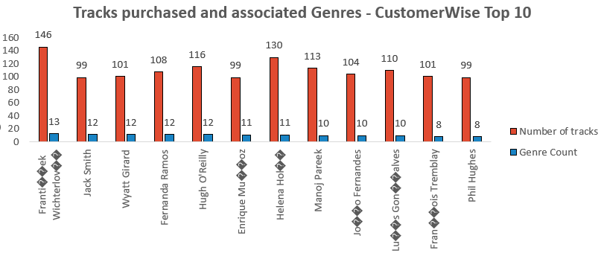
Tracks and Genre Count of each Customer
The visual besides shows us the tracks purchased by the customers. It also shows the count of genres associated to those tracks purchased.
For example, the customer named Jack Smith has purchased 99 tracks from 12 different genres which shows a diversity in the purchase made by Jack Smith.

Slide 20
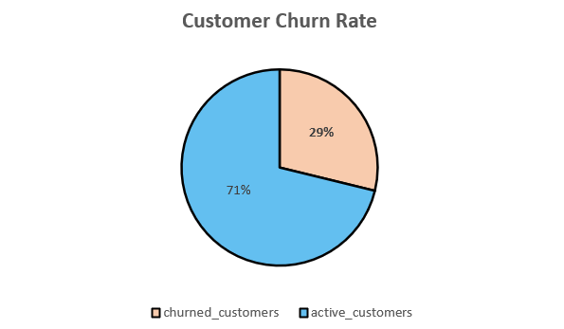
Customer Churn Rate
A customer is considered to be a churned customer if they have not made any purchase in the last 6 months.
Total Number of customers = 59
Churned customers = 17
Customer Churn Rate = 17 / 59 = 29%
The customer churn rate implies that almost 2 in every 7 customers are inactive or churned.

Slide 21
SUBJECTIVE ANALYSIS

Slide 22
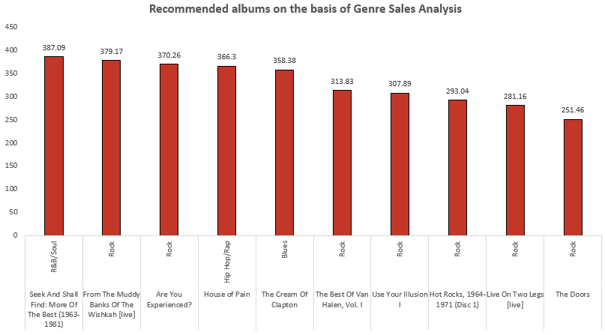
Recommendations based on Genre Sales Analysis in USA
Based on the Genre Sales Analysis, the following 3 albums can be prioritised for advertising and promotion in USA:
Rock:
The list is dominated by rock albums, which have many entries and strong sales. This indicates a large and devoted following, most likely as a result of the genre's enduring appeal in American society.
R&B / Soul:
Strong cultural significance may be the reason for this genre's great sales, as evidenced by the top album, particularly in areas with deep historical connections to the growth of R&B and Soul.

Slide 23
Recommendations based on Genre Sales Analysis in USA
3. Hip Hop / Rap or Blues:
The genres of hip hop, rap, and blues have devoted but specialized fan bases.
1. Hip Hop/Rap is especially popular among younger audiences and urban areas, where the genre often addresses themes relevant to modern life and youth culture.
2. Blues, on the other hand, appeals to audiences interested in traditional American music roots, particularly in regions with historic ties to the genre.
Hence, the three albums recommended based on the Genre Sales Analysis are [Rock], [R&B/Soul], [Hip Hop/Rap or Blues].

Slide 24
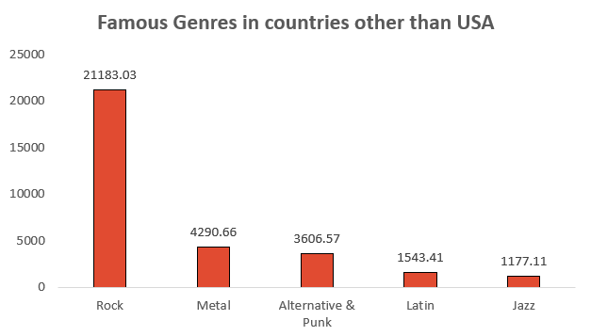
Famous Genres in countries other than USA
We can observe some similarities in terms of famous genres in countries other than USA vs USA.
In both the cases, we can observe that Rock is the most famous Genre. The 2nd and 3rd places are interchanged in case of countries other than USA. Metal is the second popular genre in countries other than USA, followed by Alternative & Punk.

Slide 25
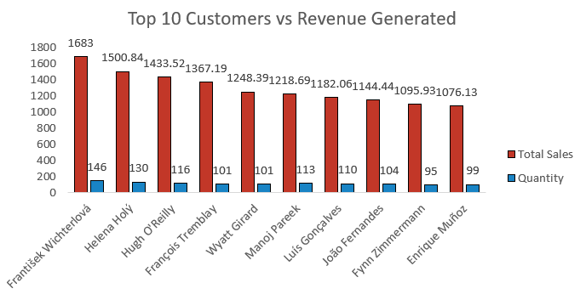
Top 10 Customers with Highest Revenues
The top 10 customers with highest revenues across the world is being displayed in the visual on the left.
The red bar specifies the total spent by the customer.
The blue bar represents the count of tracks sold.
This data can help us understand the purchasing pattern of the customers.

Slide 26
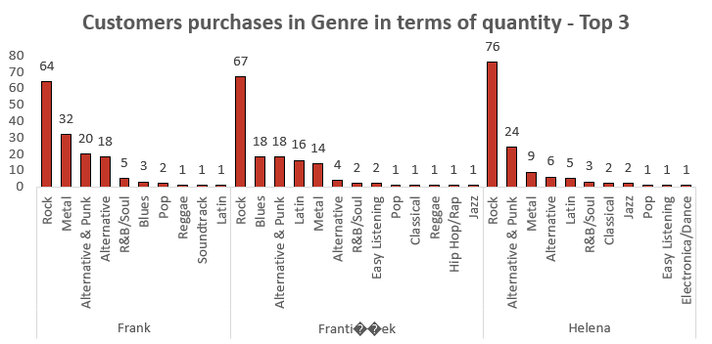
Product Affinity Analysis
Common Genres:
All three considered customers favor Rock and Metal genres, indicating a shared preference for these types of music.
Product Recommendations:
Suggesting related genres (such as Blues or Alternative) or introducing musicians inside Rock and Metal may work well for clients like Frank who buy a lot of this genre.
Cross-Selling Initiatives:
Since rock, metal, and alternative and punk music are always in style, make customized playlists for every client that feature their best songs.

Slide 27
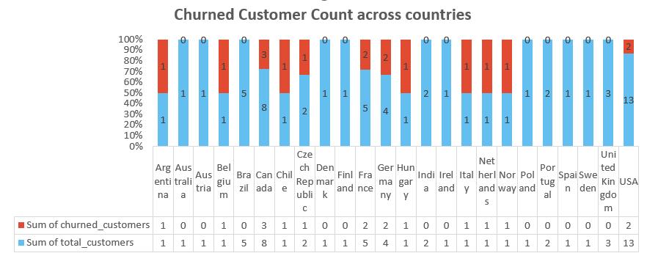
Regional Market Analysis
Based on the customer churn, the regional market analysis is performed which gives the following insights:
A customer is considered to be churned if they have not made any purchases in the last 6 months.
We can visualize that countries like Finland, Australia, India, Spain etc. have 0 churn rate which indicates that the customers in these regions are active and make frequent purchases.

Slide 28
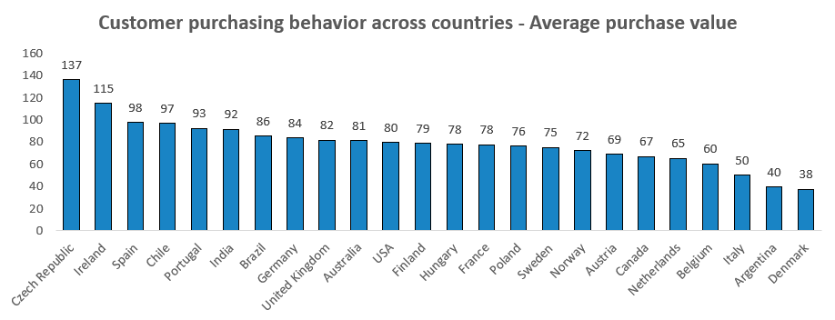
Regional Market Analysis
Based on the customer average spend, the regional market analysis is performed which gives the following insights:
Customers with high purchase value indicates that the customers in those locations place orders actively. The sales expansion can be further done in these locations.
A long history of infrequent purchases suggests a low-engagement customer who is more likely to churn.

Slide 29
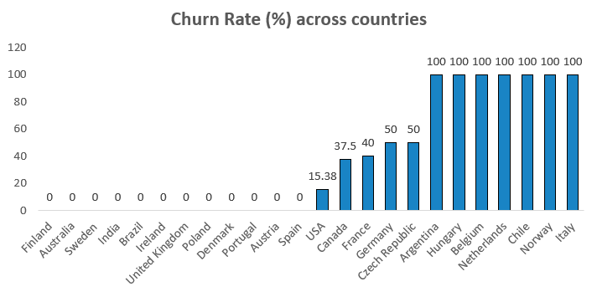
Risk Profiling based on Customer Churn Rate
By calculating churn rates by country, we can determine if certain geographical segments show consistently high churn. These rates could indicate potential service, product, or market fit issues within specific locations.
Additionally, high-volume spenders who show purchase frequency drops could signify declining interest, indicating an at-risk, high-value customer.

Slide 30
Risk Profiling based on Customer Churn Rate
Customers with low purchase frequency (like the 180-day interval in this analysis) are at higher risk of churn. These customers may only respond to specific promotional periods or are less invested in the brand’s products.
For high-churn countries, consider deploying localized marketing campaigns and enhancing service offerings to improve customer satisfaction.

Slide 31
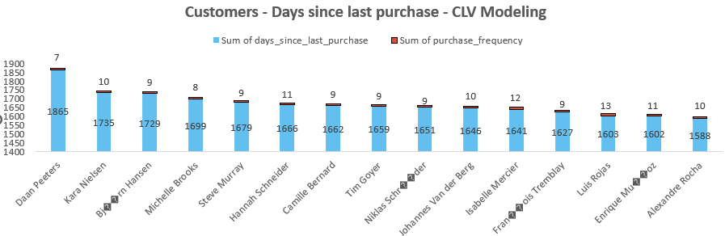
CLV Modeling : Customer Tenure
We can calculate the total spend and purchase frequency for each customer by summing up total from invoice and analyzing purchase dates.
Customers with a high value in days_since_last_purchase are at greater risk of being lost if they haven’t made purchases recently. These customers can be targeted with win-back campaigns.
Customers with long tenures but recent inactivity could be sent targeted re-engagement emails with discounts or exclusive offers.

Slide 32
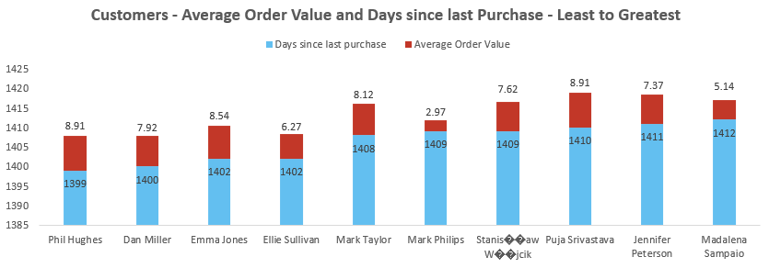
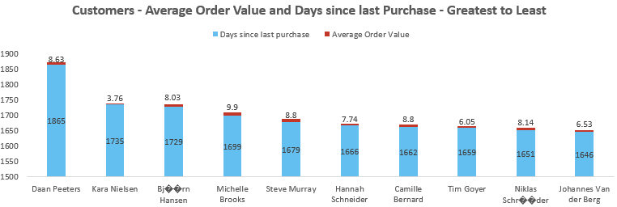
CLV Modeling : Average Order Value (AOV)
Customers who buy infrequently but have a high Average Order Value may be responsive to limited-time offers or exclusive items.
Identify customers with a high average order value and frequent purchases. These are prime targets for loyalty programs.
Observing patterns in demographics or specific genres could help tailor marketing efforts.

Slide 33
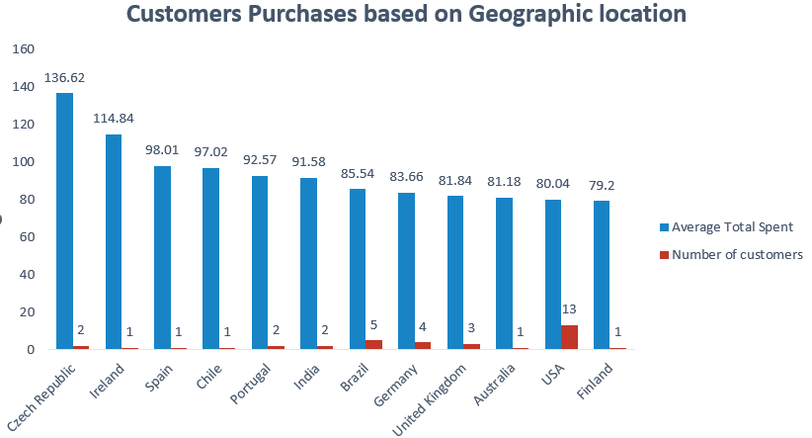
Customer Purchasing Behavior
The visual illustrates the average amount spent by each customer in each country from the given data.
We can observe that Czech Republic has the highest average total spent (136.62) per customer followed by Ireland (114.84).
This data provides us an idea of the customer distribution across the geographic locations and the spending pattern of customers in these locations.

Slide 34
Customer Purchasing Behavior Analysis
We can analyze purchasing behavior differences between long-term and new customers based on the following metrics:
Purchase Frequency:
In most cases, frequent customers make more purchases, particularly if they are very brand loyal. This might be demonstrated by comparing the average frequency of purchases over a given time period. Regular purchases might provide insights for loyalty programs or special deals that promote ongoing participation.
Basket Size:
Long-term consumers may have greater basket sizes, which suggests that they have more trust in the brand and a willingness to explore more products. Finding product combinations that are often purchased might help inform tailored cross-selling and upselling suggestions.
Average Spending Amount:
For new customers, offering introductory discounts could encourage initial spending, while targeted promotions for long-term customers could maintain or increase their average spend.

Slide 35
CONCLUSION

Slide 36
Conclusion
To conclude, the analysis done in this presentation provides insights into customer purchasing behavior and preferences based on geographic location and genre popularity, enabling targeted recommendations.
By identifying high-revenue customers and tracking purchase frequency, companies can develop strategies to re-engage inactive customers and prevent churn in high-risk segments.
The data also highlights the popularity of specific genres like Rock across locations, which can inform cross-selling and upselling opportunities tailored to regional and customer preferences.
Furthermore, differences in purchasing patterns between long-term and new customers reveal opportunities for loyalty programs and targeted offers to boost retention and customer satisfaction.

